Slide 1
Mechanical Shock
Shock and Vibration

Slide 2
Shock
Definition
Single event
Sudden substantial change in velocity
Caused by
Drops, falls and impacts

Slide 3
Shock
Measuring Shock

Slide 4
Measuring Shock
https://www.youtube.com/watch?v=YcdOqaZmBn4
Impact velocity
Rebound velocity
Velocity change
Time
https://www.youtube.com/watch?v=ZHPK5vvtnf4

Slide 5
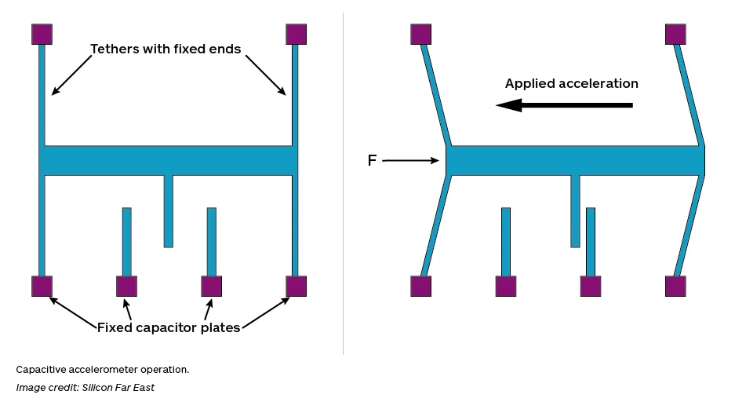
Accelerometer

Slide 6
Accelerometers
Directional
Small mass
High frequency
Good connectivity
Impacted by trailing leads

Slide 7
Shock Pulse

Slide 8
Shock Pulse Breakdown

Slide 9
Filtering

Slide 10
Shock Pulse Analysis
Peak acceleration (G)
Pulse duration
Velocity change

Slide 11
Coefficient of restitution
How much impact energy in returned in the rebound.
Typically 0.2 – 0.8
https://www.youtube.com/watch?v=YcdOqaZmBn4

Slide 12
Impact and rebound

Slide 13
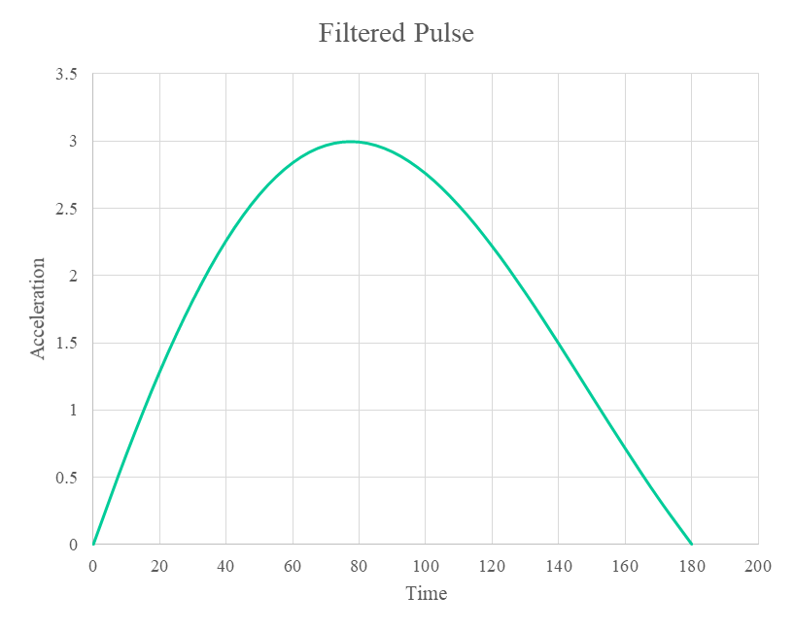
Estimating Drop Height
Determine velocity change (area under graph)
Estimate coefficient of restitution
Calculate impact velocity
Calculate drop height

Slide 14
Estimating Drop Height
Air time
Acceleration at 1G

Slide 15
Shock Intensity
How much damage will a shock cause?
What are the key measures?

Slide 16
Shock Measurement -Drop Height-
Drop height
Impact velocity
Velocity change

Slide 17
Shock Measurement -Acceleration-
Acceleration
rate of change of velocity
constantly changing over pulse
usually record peak acceleration
often expressed in “G’s”

Slide 18
Shock Pulse
Acceleration-time history over impact
Accelerations often large
Time durations often very small

Slide 19
Shock Pulse
A
c
c
e
l
e
r
a
t
I
o
n
- Peak Acceleration
Time

Slide 20
Typical Fragility
Extremely Fragile: 15 - 25 G Precision Instruments
Fragile: 25 -40 G Electronics, Instruments
Stable: 40 - 60 G Office Equipment
Durable: 60 - 80 G TV Printers
Rugged: 85 - 110 G Domestic Durable
Portable: 110 G
Hand held: 150 G

Slide 21
Fragility Modification
Increase Strength
Disassemble
Cushion
Increase impact time
Lower acceleration

Slide 22


Slide 23
Shock Measurement
Velocity Change
Peak acceleration
Damage Boundary Curve

Slide 24
Damage Boundary Curve
A
Acceleration
B
C
Velocity Change

Slide 25
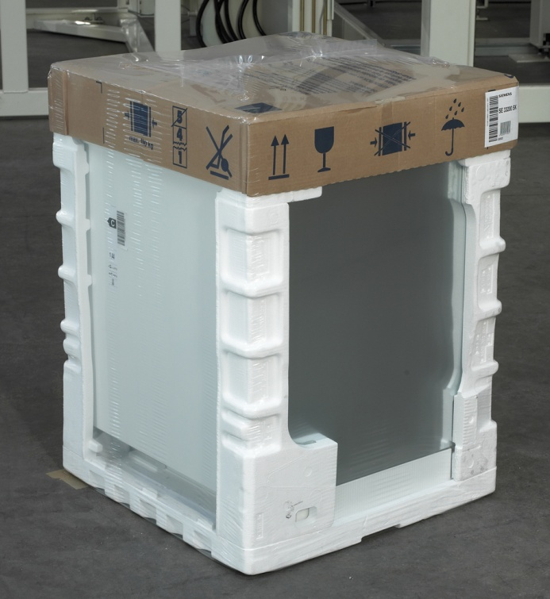
Shock Reduction
Change Environment
Distribution Channel
Training
Change Package

Slide 26
Shock Reduction
Cushion Theory
Product always lands on soft surface
Increase impact time
Reduce acceleration

Slide 27
Ideal Cushion
Compress to zero thickness
Constant accelerations throughout
Resilient

Slide 28
Cushion Design: Ideal Cushion
t = h/G
t cushion thickness
h drop height
G product fragility (peak acceleration)

Slide 29
Cushion Design: Cushion Factor
t = Ch/G
t cushion thickness
C cushion factor
h drop height
G product fragility (peak acceleration)

Slide 30
Cushion Factor
Material | Density Kg/m3 | Cushion factor | Static stress KPa
Expanded polystyrene | 16 | 3.1 | 13.7
Expanded Polyethylene | 37 | 3.2 | 6.9
Expanded Polyethylene | 45 | 2.6 | 10.8
Polyurethane Chip foam | 64 | 3 | 1.8
Polyurethane Chip foam | 96 | 3 | 2.5

Slide 31
Cushion Design (Cushion Curves)
Information Required
Product size & weight
Product Fragility
Anticipated drop height
Products need for support

Slide 32
Dynamic Cushion Curves
25 mm
50 mm
Acceleration
75 mm
100 mm
150 mm
Static Stress

Slide 33
Cushion Types
Loose Fill
Moulded
Foam in place
Suspension
Blister/Pillow

Slide 34
Cushion Materials
Paper and board
Starch based materials
Polymers
Air

Slide 35
Predicting shock potential
Drop height frequency
Pack size
Pack weight
Handles
Pack orientation
Labelling

